Slide 1
Introduction to Financial Markets
Pukar Sharma

Slide 2
Overview
Overview and Understanding Market Mechanics
Introduction to Financial Markets
Basic Concepts of Market Participation

Slide 3
INTRODUCTION
A financial market is a marketplace where buyers and sellers trade financial assets such as stocks, bonds, commodities, and currencies.

Slide 4
Types of Financial Market
Stock Market: Where shares of public companies are traded.
Forex Market: Where currencies are traded.
Commodities Market: Where raw materials and primary products are traded.

Slide 5
Stock Market
The stock market is a platform for buying and selling shares of companies.
Key Concepts:
Stocks: Units of ownership in a company.
Exchanges: Platforms like NYSE, NASDAQ, and NEPSE where stocks are traded.
Indices: Indicators of market performance, e.g., S&P 500, Dow Jones, NEPSE Index.

Slide 6

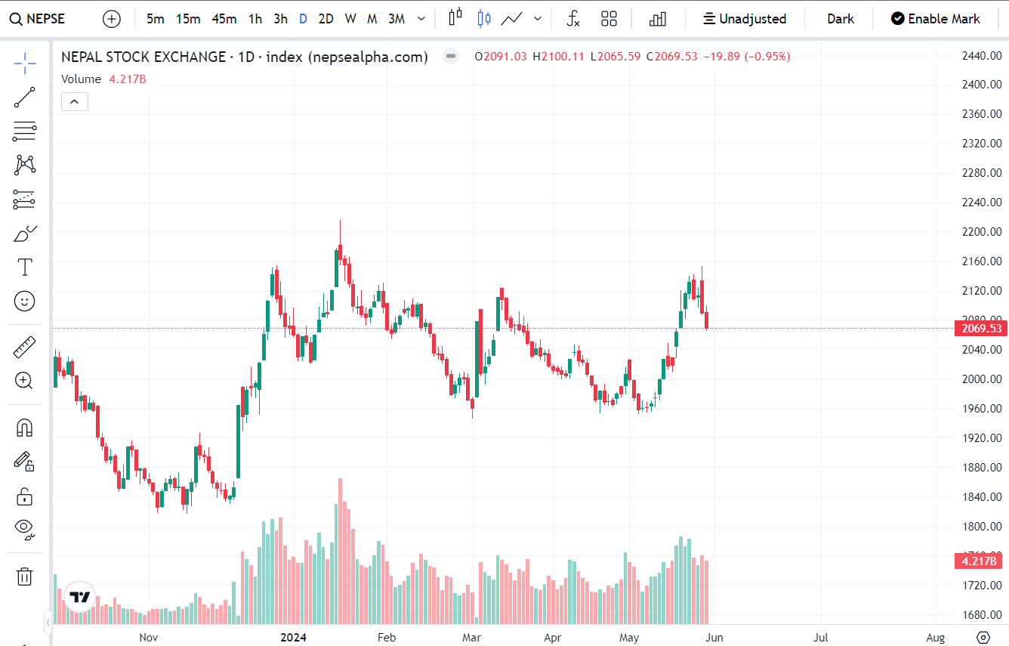
NEPSE (Nepal Stock Exchange):
The main stock exchange in Nepal.
Trading hours and key characteristics.

Slide 7

Forex Market
The forex market is where currencies are traded.
Key Concepts:
Currency Pairs: Trading one currency for another, e.g., EUR/USD.
Exchange Rates: The value of one currency in terms of another.
Pips: The smallest price move that a given exchange rate can make.

Slide 8
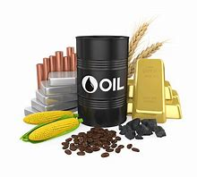
Commodities Market
The commodities market deals with the trading of raw materials.
Key Concepts:
Commodities: Physical goods like gold, oil, and agricultural products.
Futures Contracts: Agreements to buy or sell a commodity at a future date.

Slide 9
TYPES OF Market Participants
Retail Traders
Institutional Traders
Market Makers
Individual investors trading with personal accounts.
Entities like banks, mutual funds, and insurance companies that trade in large volumes.
Brokerage

Slide 10
Things that affect market
ECONOMIC INDICATOR
POLITICAL EVENTS
INTEREST RATE, CD ratio etc.
Policies like monetary policies, Financial Acts etc.
Fundamentals, Good news
Change in government,
E.g. Due to the news of news of new Finance minister, market hit three circuit break and closed (Bishnu Poudel)
Rumors like Big Political changes,
Global Politics ( WAR, economic blockade)
Pandemic Effect

Slide 11
Understanding market mechanisms
Market Session
Liquidity
Order Types and Execution
NEPSE is opened form 11 AM to 3 PM
Sunday to Thursday
Pre open session
A market with a high amount of liquidity has many buyers and sellers.
A market with low liquidity has fewer buyers and sellers.
MARKET ORDERS prioritize speed and are executed immediately at the best available price.
LIMIT ORDERS prioritize price control and are executed only if the market reaches the specified price.

Slide 12
SUMMARY
Types of Financial Markets:
Stock Market
Forex Market
Commodities Market
Market Influencing Factors:
Economic Indicators (Interest Rates, Policies)
Political Events (Government Changes, Global Politics)
Pandemics
Market Participants:
Retail Traders
Institutional Traders
Market Makers
Market Mechanisms:
Liquidity
Order Types (Market Orders, Limit Orders)

Slide 13
SUMMARY
We have discussed important topics such as the different types of financial markets, the factors that affect the market, the types of market participants, and the market mechanisms.

Slide 14

THANK YOU
Pukar Sharma
sharmapukar98@gmail.com

